Slide 1
LOST &
FOUND
BING NEWS MOBILE
DESIGN EXPLORATION
Yifei Gong September 2019

Slide 2
Current Stage
Bing News Vertical
Mobile Design
New version(2019) design ready for implementing
Notes:
So I’m going to unpack each current pain point and solution one by one.
The first one is lost focus which brought by long reading list, quick scrolling down and view the content in a same pattern.
People’s perception is getting flatten.

Slide 3
Starting point
NEWS=BREAKING

Slide 4
READ NEWS=BORING
Notes:
News is a breaking image in common sense. But when people talking about is, people feel like reading news is boring.

Slide 5
Unmeted PAIN POINTS
Lost Focus
Lost focus while reading
Lost Interest
Hard to get personalized content
Lost Update
Hard to catch-up since last time read
Notes:
The reasons behind it through my research are while reading new, lost focus, lost interest an lost update make them feel actively reading news is boring.

Slide 6
LOST
Notes:
Lost is certainly a passive word to describe the current experience.

Slide 7
FOUND
Opportunity AREA
Notes:
And the solutions I’ve explored are around Found.

Slide 8
PAIN POINT 1
LOST FOCUS
Long reading list with same pattern would make users feel boring
Notes:
So I’m going to unpack each current pain point and solution one by one.
The first one is lost focus which brought by long reading list, quick scrolling down and view the content in a same pattern.
People’s perception is getting flatten.

Slide 9
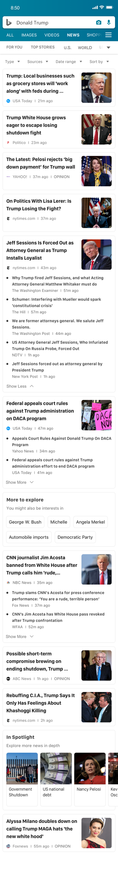
Current Problem
While emerging in browsing the news list with some repeated pattern, the perception is getting flattened.

Slide 10
Focus
How to create this point
To catch user’s focus back
Reading Time
When did they lost focus
Notes:
When do they feel lost

Slide 11
Focus
Fill new content
Reading Time
Design direction 1
Notes:
When do they feel lost

Slide 12
Design direction 1
Load New Articles
When they emerging in a long reading list, while scrolling down, the content is getting not up-to-date.

Slide 13

What could attract them?
74% of mobile news app users expect real-time content updates.
Mobile News Apps Survey Results, June 2017
Notes:
What could attract their focus?

Slide 14
Real-time News ✅
Algorithm Capacity ✅
Feasibility
Notes:
New content is being generated every second.
We have technology to integrate.

Slide 15
Let users know
What happened just now
HMW

Slide 16
CURRENT DESIGN
Doesn’t have a home button
Users should at least go back to the first screen to refresh by tapping the top bar or manually going back.

Slide 17
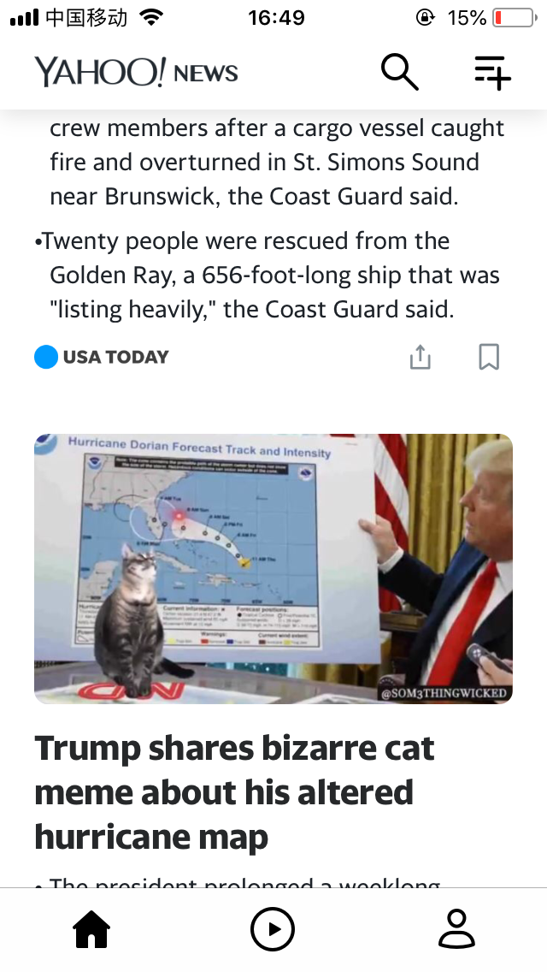
COMMON SOLUTION 1
Quick double tap home button

Slide 18
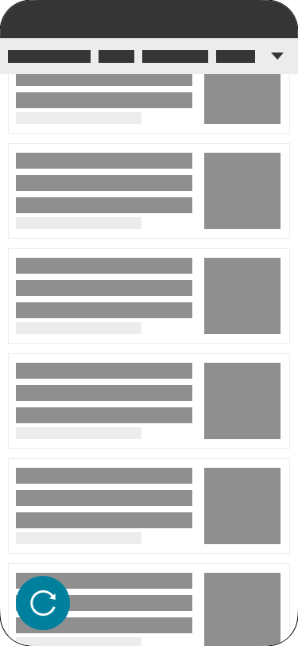
Design 1 quick refresh
On the left bottom corner
Show it when users scroll up quickly
Go back to top and refresh the current page after tapping it
Search result list
Top stories
For you
Category page
Topic page

Slide 19

Design 1 quick refresh
PROS
No distract or attract people actively refresh since it’s triggered by action
Left corner is more useful ergonomically
CONS
May not be able to get new result

Slide 20
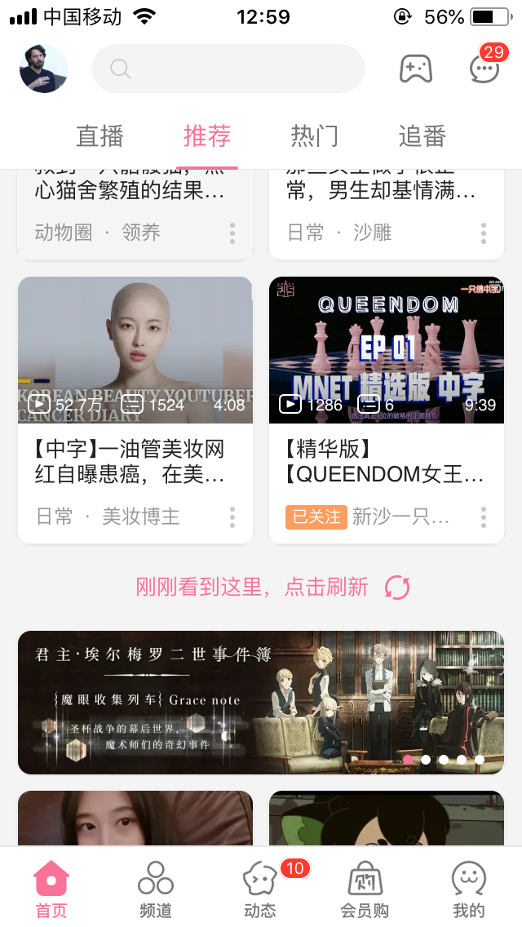
COMMON SOLUTION 2
Video platform
Record the last refresh browsing progress
Show in the list

Slide 21
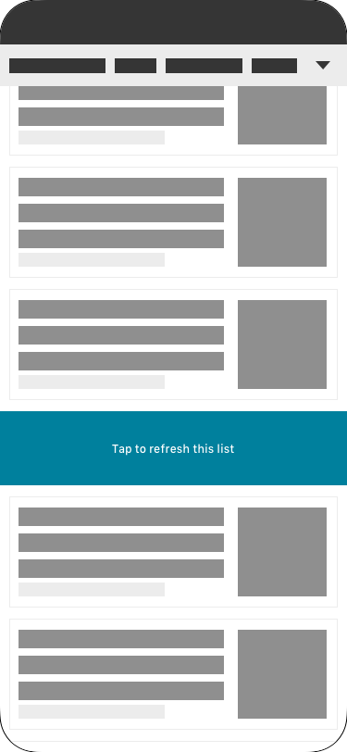
Design 2 refresh section
Locate in a relative position loaded last time
Serve as a section to separate the list
Tap to load new content and keep the current content under the new content
Go back to the top and load the new articles
Top stories
For you

Slide 22
Design 2 refresh section
PROS
Cut the scrolling down and show up before users feel
CONS
Disturb their current reading
Read repeated content if want to go back
Don’t know number of new article since it’s pre-loaded
Disappear with the list if no action

Slide 23
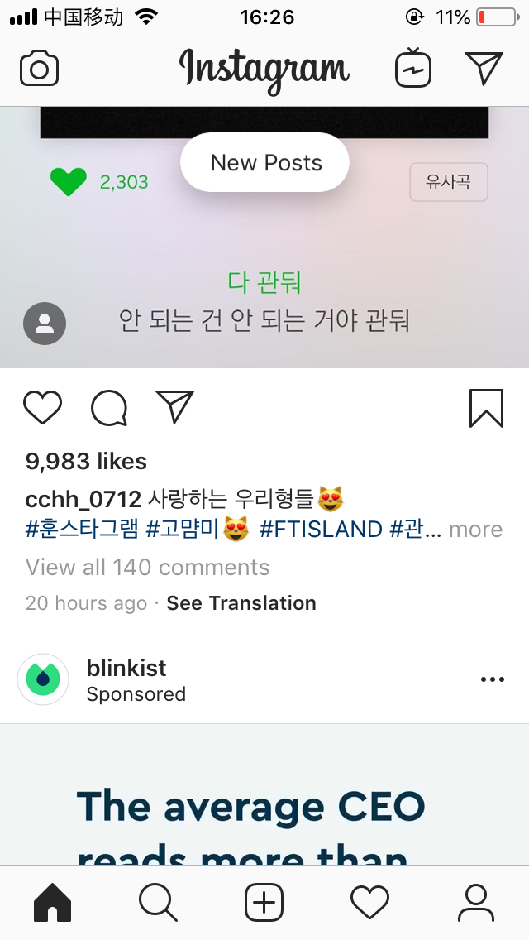
Reuters
COMMON SOLUTION 3
Instagram
A floating button to notify users new posts
Reuters
Tiny refresh notification with number on the top of the category page

Slide 24
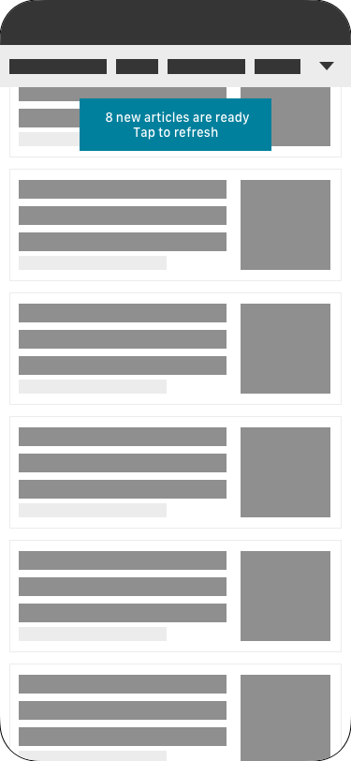
Design 3 refresh notification
On the top of the list area while a certain number of new articles are ready
Show the number of new articles and instructions
Go back to the list top and load the new articles
Search result
Top stories
For you
Category page

Slide 25
Design 3 refresh notification
PROS
Able to know how many new article they could get and how to use this function
CONS
It won’t be triggered if only have a few new articles
Users don’t know the exact content of them, if tap, they also lost the current reading progress

Slide 26
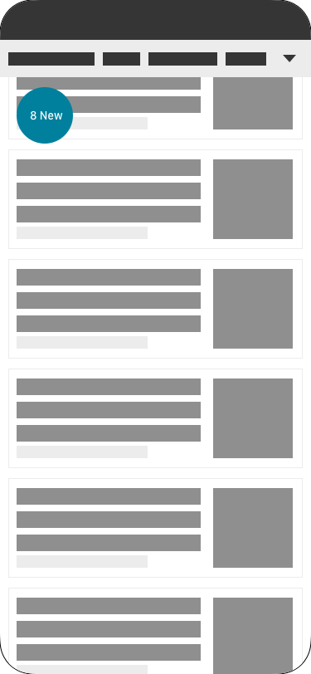
Design 4 floating number
Integrated in a collection
Show the number of new articles when it’s above a certain number
Could renew in real-time
Go back to the top and load the new articles
Search result
Top stories
For you
Category page

Slide 27
Design 3 floating number
PROS
Responsive in real-time
CONS
Number represent what is no clear

Slide 28

EXPLORATION
INTEGRATE THE DESIGN 3 AND 4
Show up in status 1 in x seconds
Contract to a smaller circle after y seconds
Status 1 Showing up
Status 2 Contracting

Slide 29
Design direction 2
Trending Topics

Slide 30
Focus
Jump to new category or topic
Reading Time
Design direction 1
Notes:
When do they feel lost

Slide 31
Land to the Comprehensive view page✅
Feasibility

Slide 32
Help users know a more comprehensive view about the trending topics just happened
HMW

Slide 33
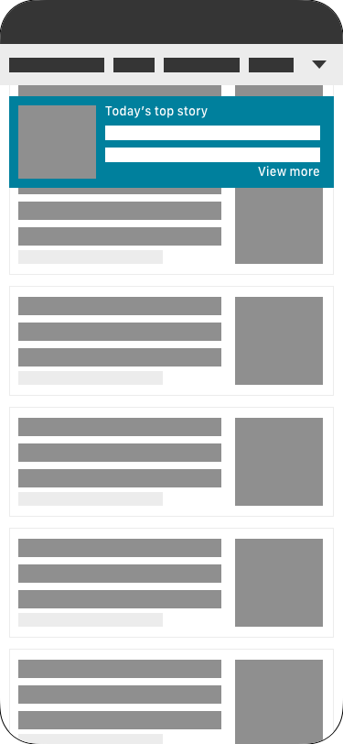
DESIGN 1 TOP STORY RECOMMENDATION
On the top of the list area
Tap [View more] jump to the comprehensive view page of this story
Top stories

Slide 34
DESIGN 1 Top Story Recommendation
PROS
A cover image is preferable and a part of the story
CONS
The importance seems be improved as a recommendation which possiblely has bias

Slide 35
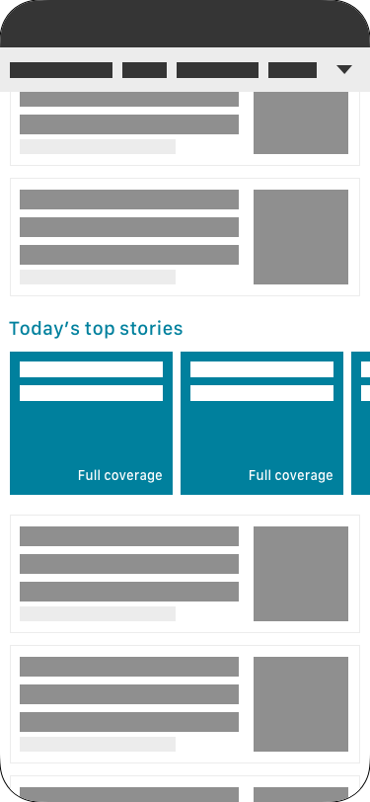
DESIGN 2 TOP STORIES CAROUSEL
Show up in the news list to separate the news list
Tap view more then jump to the comprehensive page of this story
Top stories

Slide 36
DESIGN 2 Top Stories Carousel
PROS
Cut the current reading curve to create new stimulus
CONS
Might be repeated content

Slide 37
Design direction 3
Interactive News Stand

Slide 38
Focus
New pattern
Reading Time
Design direction 1
Notes:
When do they feel lost

Slide 39
Quickly Scrolling Down=Not Impressing
Assumption

Slide 40
Show the top news with corresponding importance
HMW

Slide 41
How to?
People gravitated towards designs that had larger images, brighter color/designs, immediate customization options, and contextual references.
(2)
Notes:
What could attract their focus?

Slide 42
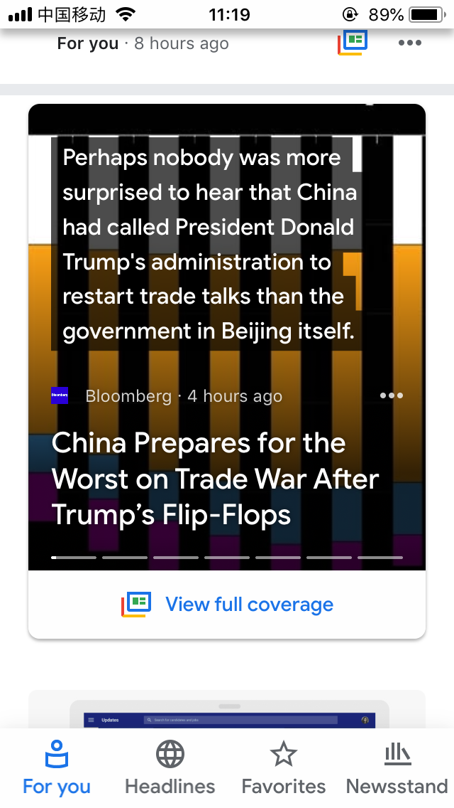
COMPETITOR 1
Google News
An interactive experience for a more immersive multimedia news digestion.
Google has its well designed interactions that allows users read various source news of the same event
Including news(Headline, snippets, thumbnail, publisher, published time), social, video, opinion

Slide 43
How do people perceive news?
Notes:
Let’s back to the core question.

Slide 44
How do people perceive news?
Common answers
Comprehensive, No bias

Slide 45
How do people perceive news?
Real actions
From their trusted or preferred publisher

Slide 46
Help user perceive a more comprehensive view of news
HMW

Slide 47
How to?
Participants preferred options that let them get to the content as quickly as possible, whether that was an aggregated vertical page or answer, or to an article they wanted to read. Minimizing taps and getting right to the information were the most desired outcomes.
Mobile Breaking News Focus Group Findings, March 2017
Notes:
What could attract their focus?

Slide 48
METHOD 1 A LIST OF PUBLISHER‘S FAVICONS
Users have some preferred publishers and know their names and favicons
Show the list of publishers to help them perceive and compare different point of views

Slide 49
How to?
Participants also preferred experiences that provided a variety of content types (articles, videos, etc.) that let them choose the best way to get information given their current context.
Mobile Breaking News Focus Group Findings, March 2017
Notes:
What could attract their focus?

Slide 50
METHOD 2 VARIETY CONTENT
Show the videos, rundown, cluster and perspective on the card to avoid extra efforts of tapping and jumping

Slide 51
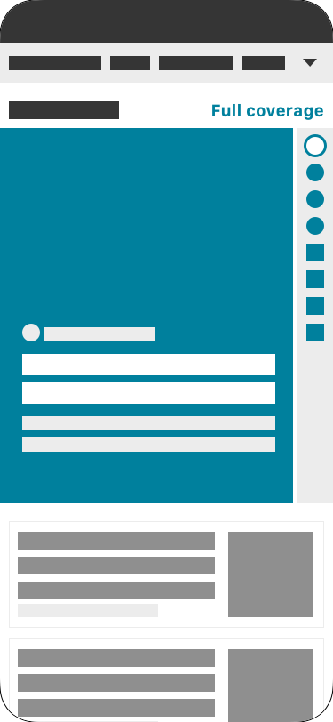
DESIGN 1 VERTICAL SIDE CONTROLLER
Make publisher favicon as a vertical controller
Show multimedia options

Slide 52
MOTION BREAK DOWN
Scrolling
Regular card
Jump to Article
Stop
Active motion
Indicator
Focusing
Countdown
Shift

Slide 53
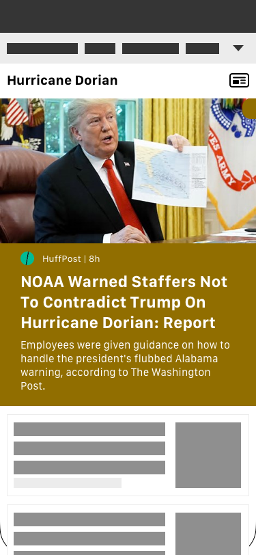
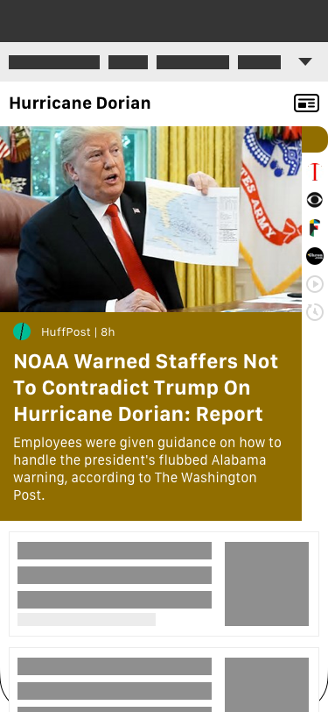

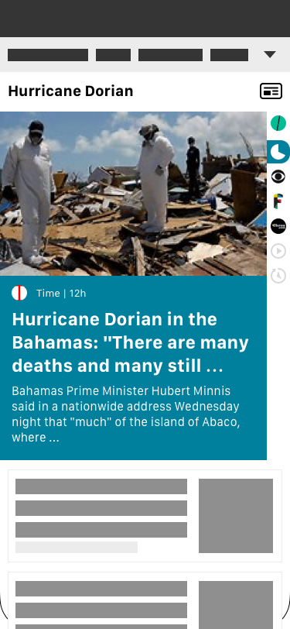
MOTION BREAK DOWN
Scrolling
Regular card
Jump to Article
Stop
Active motion
Indicator
Focusing
Countdown
Shift

Slide 54

COUNTDOWN 1

Slide 55
DESIGN 1 VERTICAL SIDE CONTROLLER
PROS
Imitation of the news paper stand
CONS
Some of the articles may not have a high quality thumbnail

Slide 56
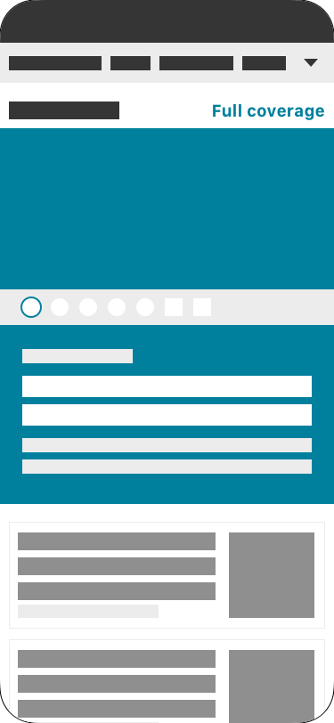
DESIGN 2 BELT CONTROLLER
On the middle of the card
The thumbnail doesn’t move while shifting

Slide 57

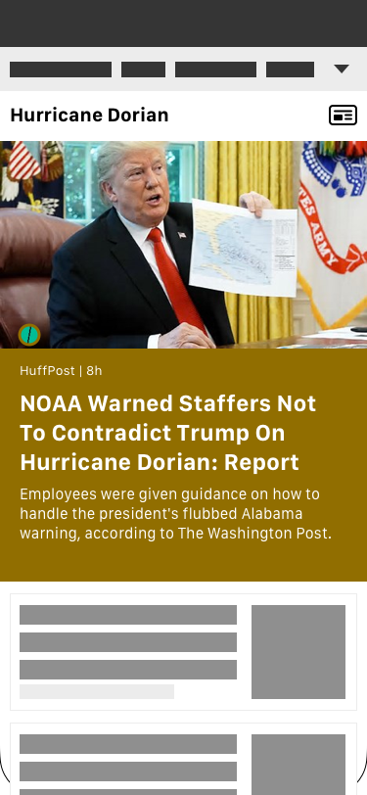
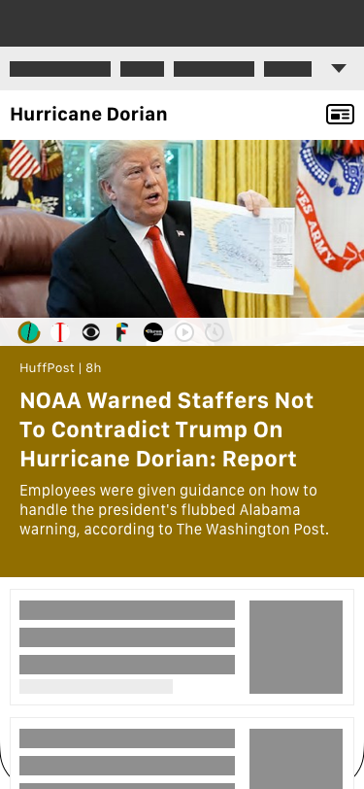
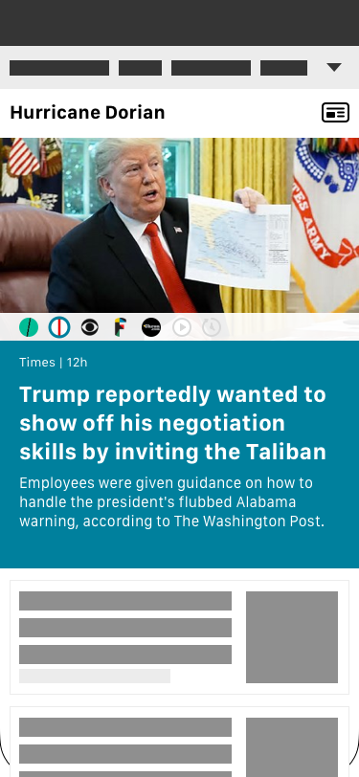
BREAK DOWN
Scrolling
Regular card
Jump to Article
Stop
Active motion
Indicator
Focusing
Countdown
Shifting

Slide 58

COUNTDOWN 2

Slide 59
DESIGN 2 BELT CONTROLLER
PROS
The favicon is located near the name of the publisher which would be clearer for users to understand
CONS
Since the belt separate the card into two sections, the thumbnail is better not to change

Slide 60
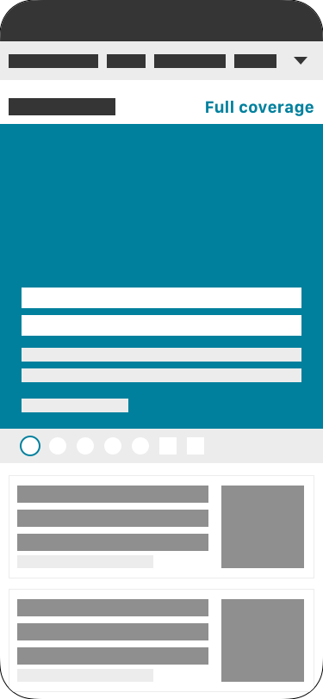
DESIGN 3 BOTTOM
It show up on the bottom
The picture and content change together while shifting

Slide 61
DESIGN 3 BOTTOM CONTROLLER
PROS
The thumbnail could shift with the article
CONS
It is a bit strange while the motion haven’t been active (there is only one favicon on the bottom of the card)

Slide 62
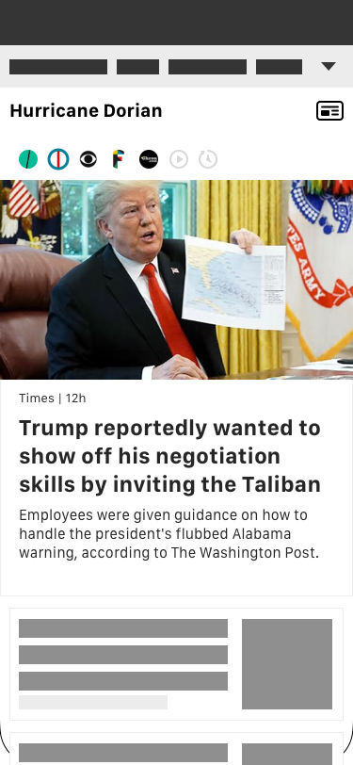
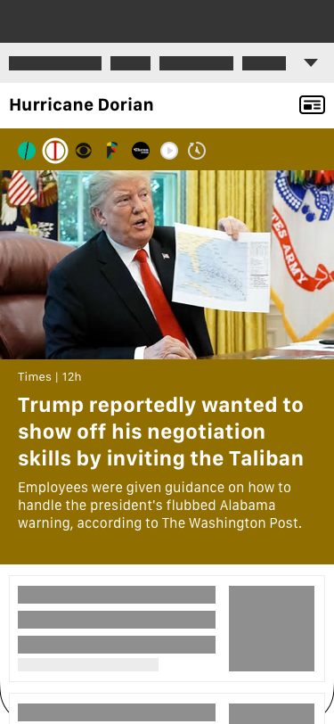
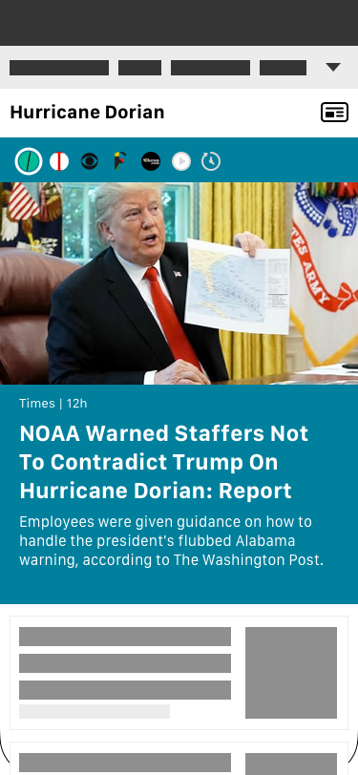
Other Explorations

Slide 63
Problem 2
Some users are uncertain about what kind of content they could see in the landing page or don’t know what is full coverage.

Slide 64
Don’t know what’s in it
The importance is not enough for taking actions
fear

Slide 65
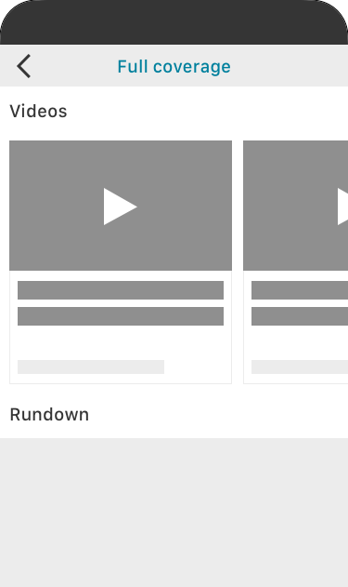
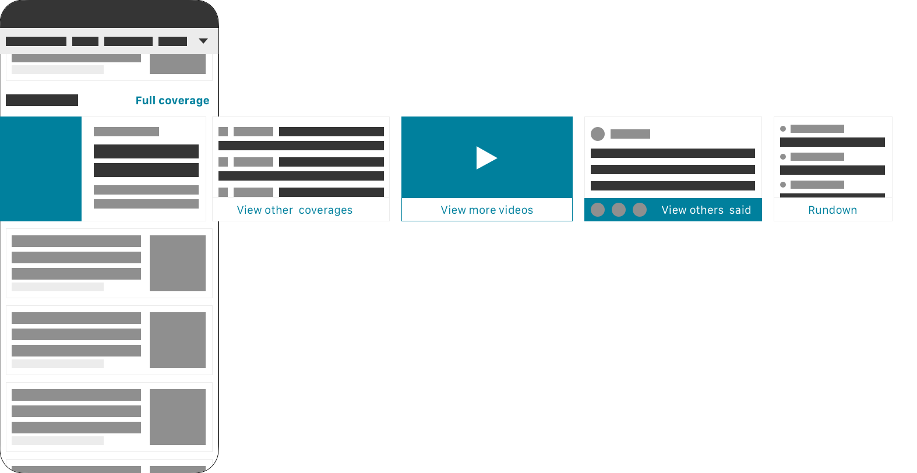
DESIGN 2 REDIRECT
Show a preview of the comprehensive view page content as single card
Jump to the anchor point of the section
Cluster
Video
Perspectives
Rundown

Slide 66
DESIGN 4 REDIRECT
PROS
Preview makes users no need to go into full coverage
CONS
The content of full coverage would expose less

Slide 67
PAIN POINT 2
LOST INTEREST
Hard to get personalized content
Notes:
But there is another part of this problem, why people lost their focus on our design, may be they couldn’t find the topics they are interested in.

Slide 68
Expectation
Users prefer content to be organized by category/topic.
Mobile News Apps Survey Results, June 2017
Notes:
What could attract their focus?

Slide 69
Barrier
Mobile news app users say they want personalized content, but few have taken steps to get it.(1)
Mobile News Apps Survey Results, June 2017
Notes:
What could attract their focus?

Slide 70
Expectation
People want easier, more immediate ways to personalize their feed to make it more useful and engaging.
Mobile News Apps Survey Results, June 2017
Notes:
What could attract their focus?

Slide 71
Desktop [Interest] related features
haven’t be aligned
Gap

Slide 72
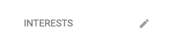
CURRENT DESIGN
Only on desktop, they could manage their interest.

Slide 73
Make a more visible
personalized feed and navigation
HMW

Slide 74
User Journey
See a new topic
Follow the topic
Read current content
Know update
Read update
Manage

Slide 75

User flow 1 follow and read
Entry Point
See the topic
Follow the topic
Read current content
Search Result
Follow
Comprehensive View Page
Browse News
All interests

Slide 76
BING NEWS SPOTLIGHT
11
11

Slide 77
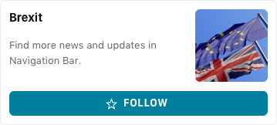
ENTRY POINT-SEARCH RESULT
Current design
Topic follow card
User feedback
The topic follow button doesn’t make sense to users.(mobile user study 2019)
“I don’t know I’m gonna follow what.”

Slide 78
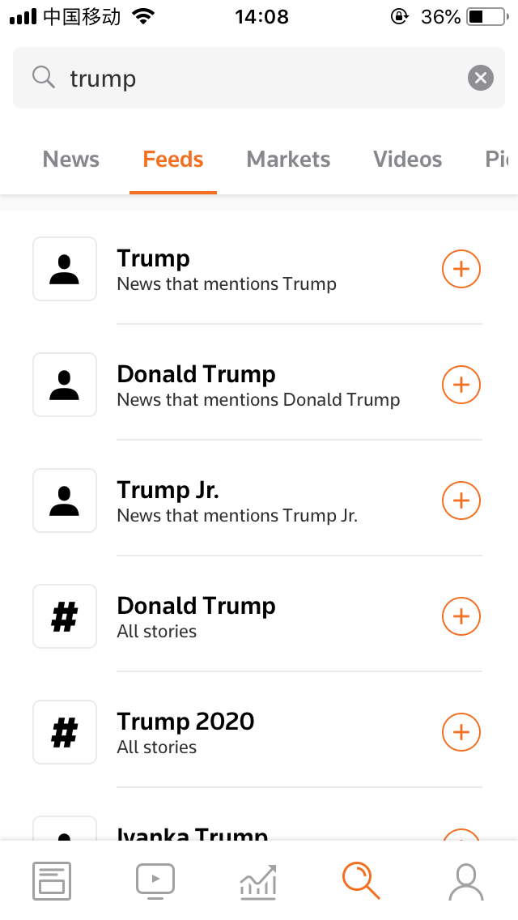
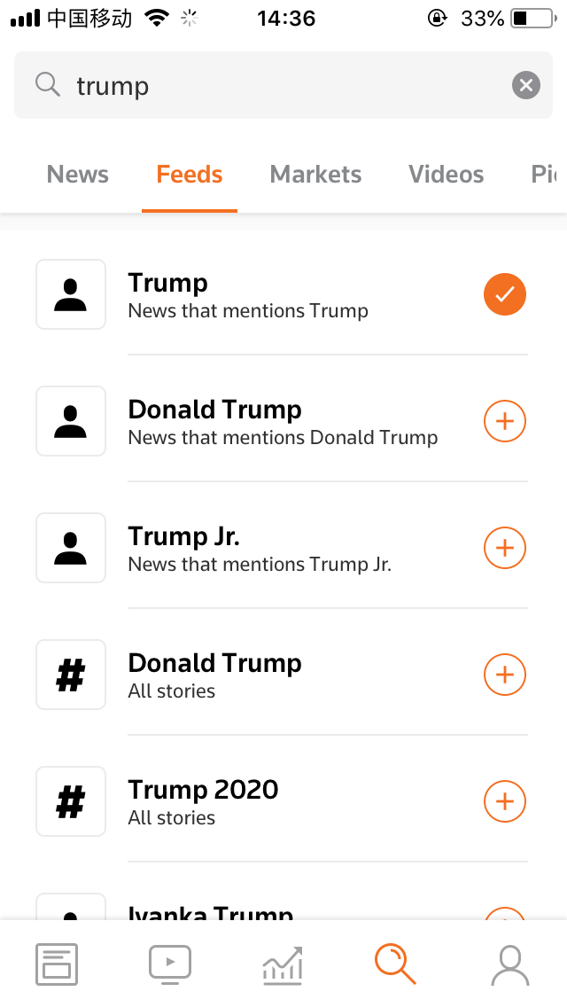
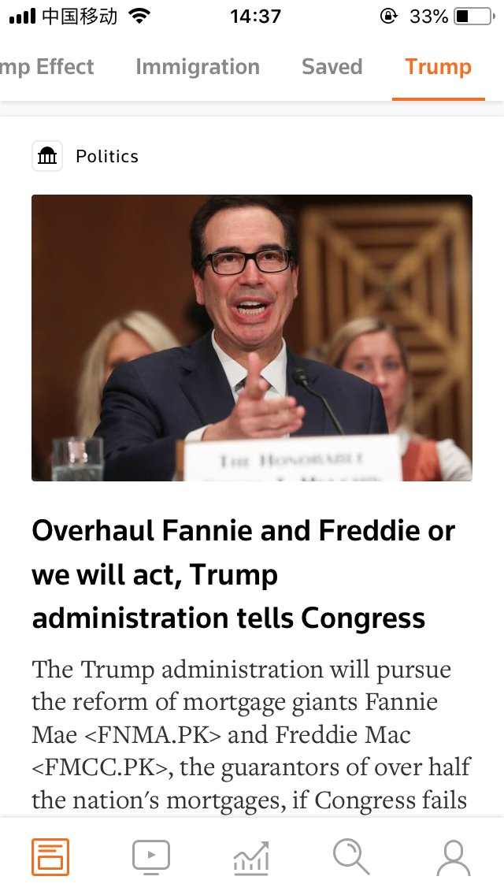
Reuters
Search
Follow
Entry point and feed

Slide 79
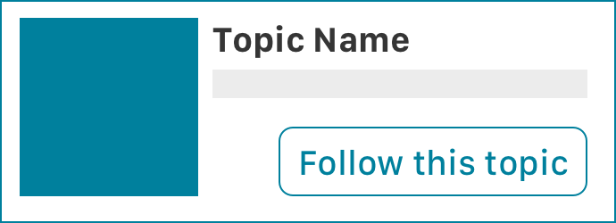
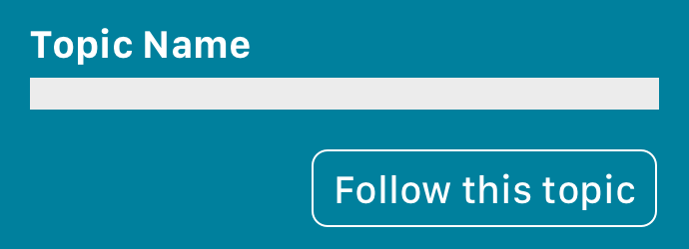
ENTRY POINT 1 SEARCH RESULT
Proposal
Change the ux writing to follow +topic name
Make the follow button into the main section, mix with name, description and picture

Slide 80
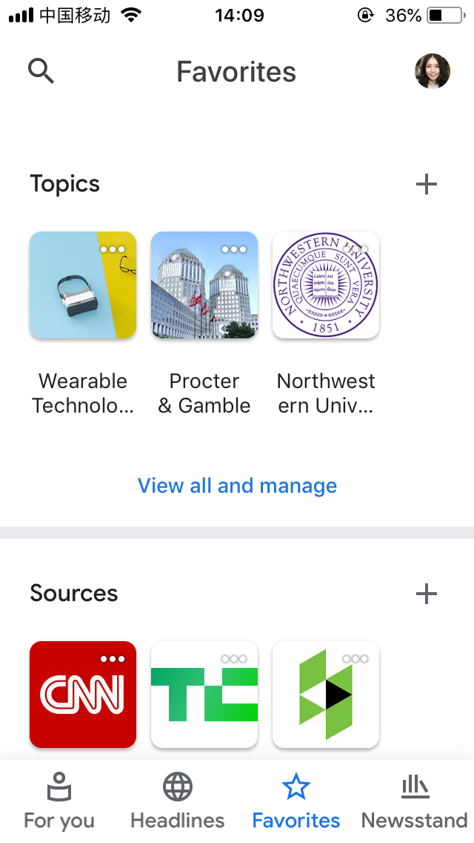
COMPETITORS
Google News Favorite Tab
Reuters My feed

Slide 81
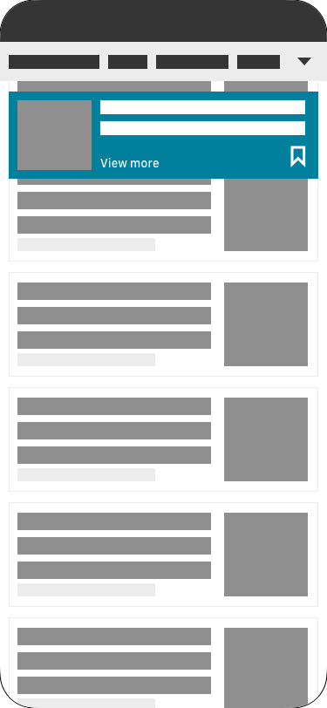
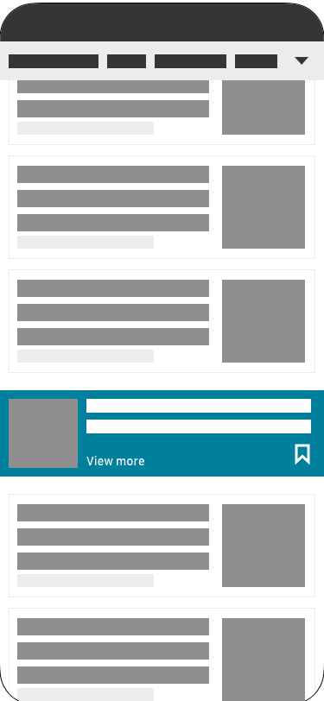
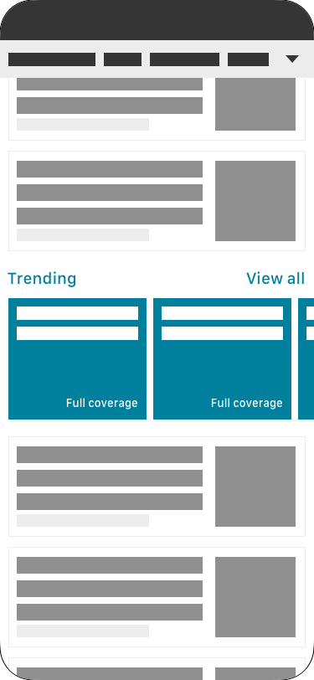
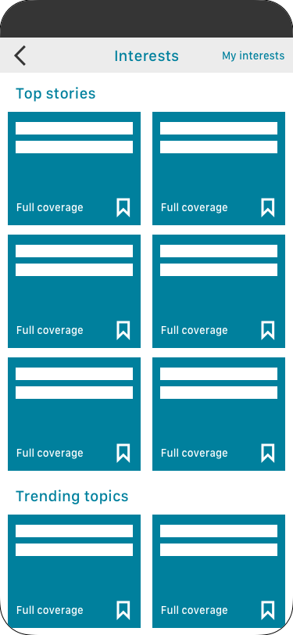
1. ENTRY POINT-BROWSE NEWS
Single
Separate Pop up
Single
Separate In list
Group
Mix In list
Group
Seperate page

Slide 82

Follow Interest Card
Requirements
Interest Name
Follow
Unfollow
Entry Hot Spot
(Thumbnail)
(Summary)

Slide 83
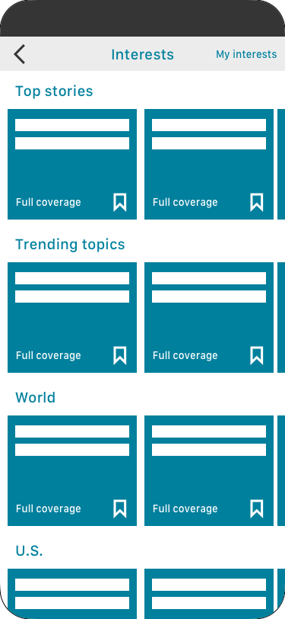
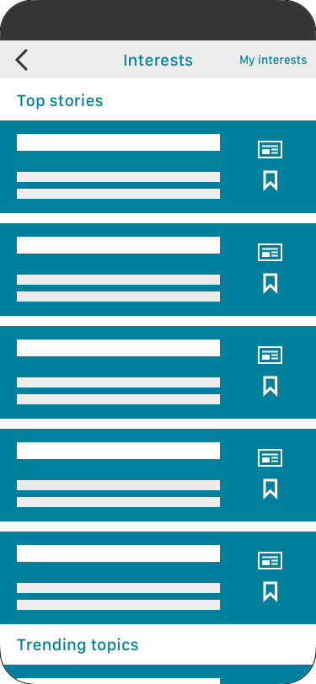
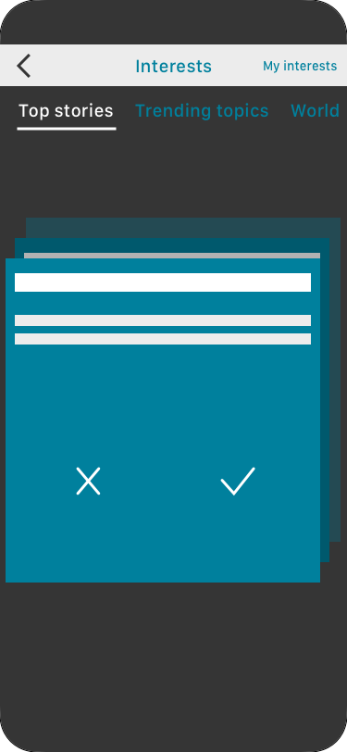
FOLLOW All Interests List-Recommend Mode
Carousel
View all the category
List
Smoothly scrolling
2 Column List
Efficient
Cards Collection
Immersive

Slide 84
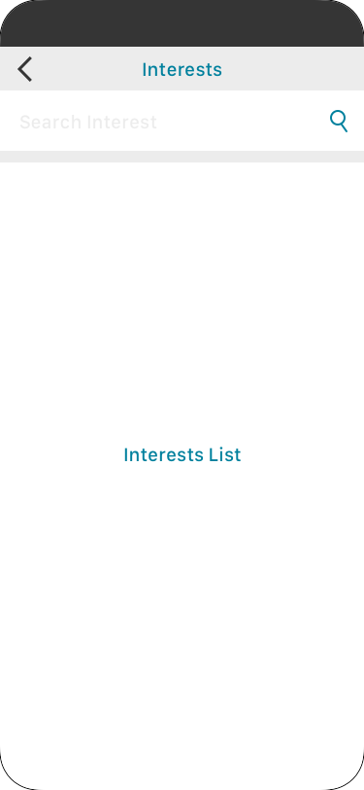
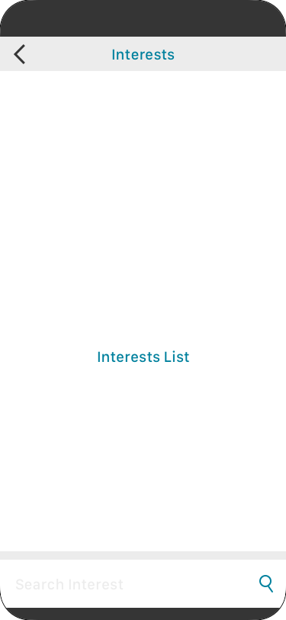
FOLLOW All Interests List-Explore Mode
Top Search Bar
Bottom Search Bar

Slide 85
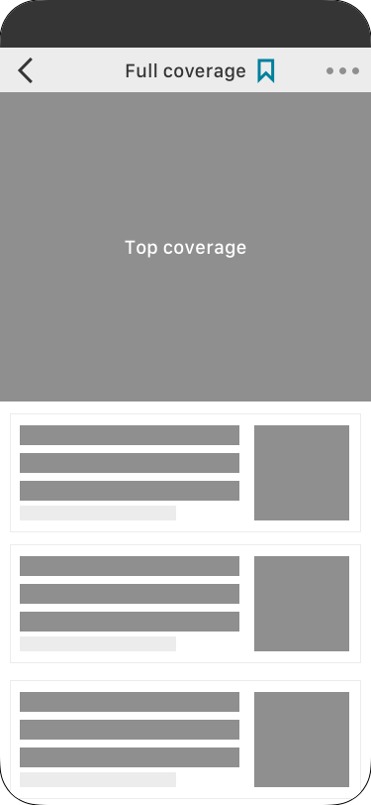
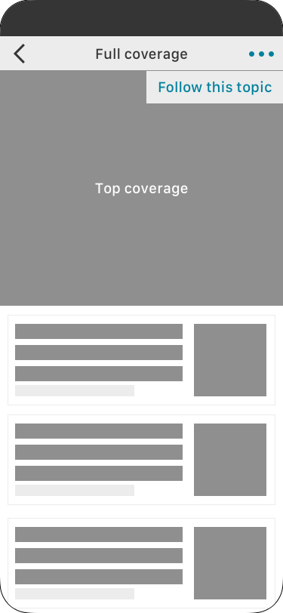
1. ENTRY POINT-COMPREHENSIVE VIEW PAGE
Icon
More

Slide 86
READ
Comprehensive view Pages

Slide 87

User flow 2
Manage
Follow
Unfollow
Follow
Follow
My Interests Page

Slide 88
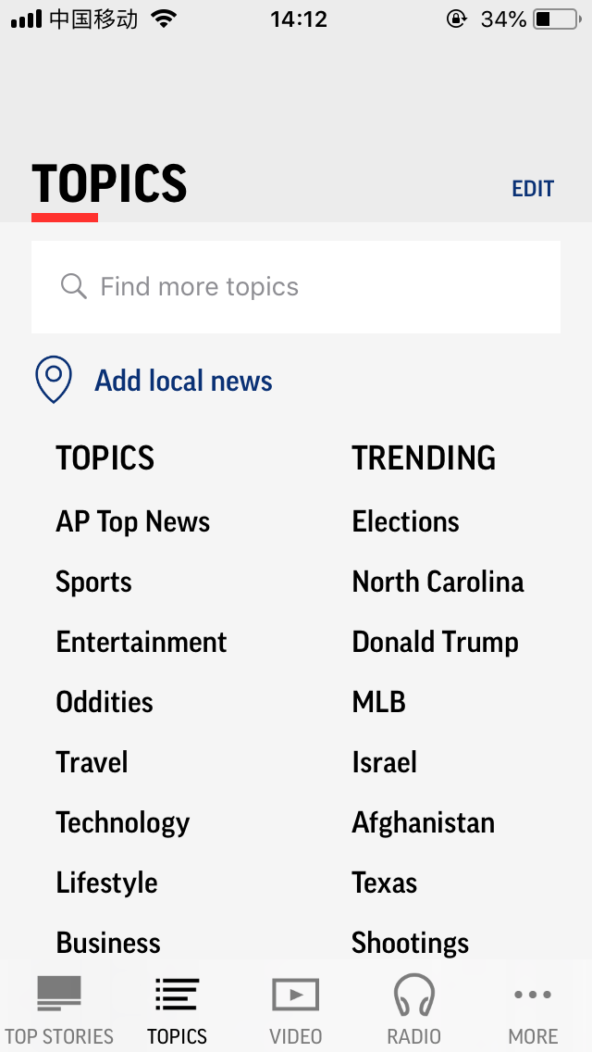
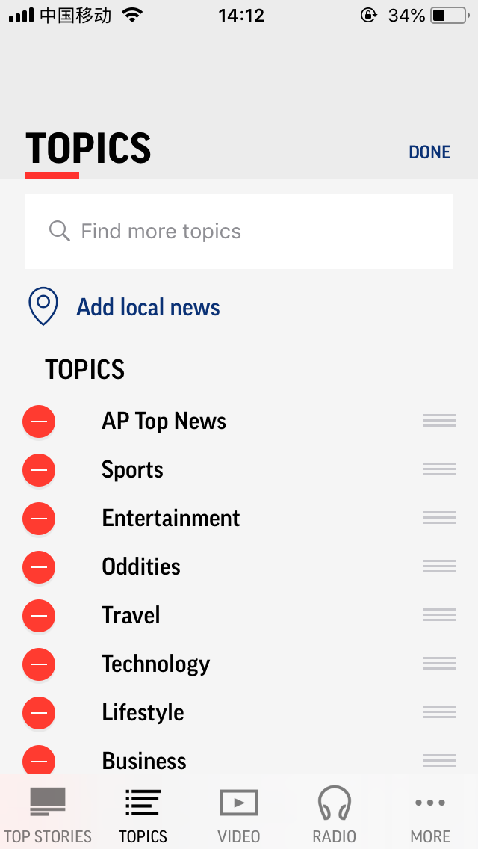
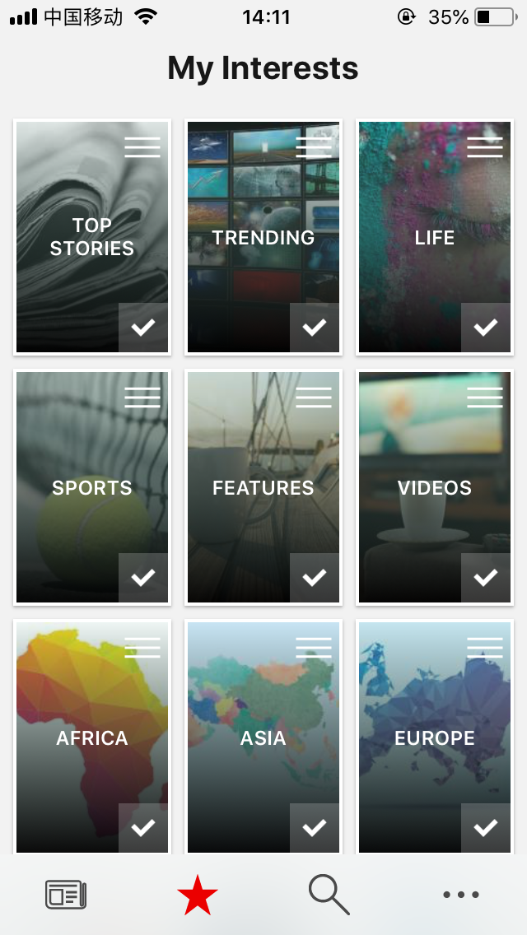

FOLLOWED MANAGEMENT
AP News
Microsoft News
Google News

Slide 89

2. MANAGE
Card Requirements
Interest Name
Full coverage entrance
Unfollow

Slide 90
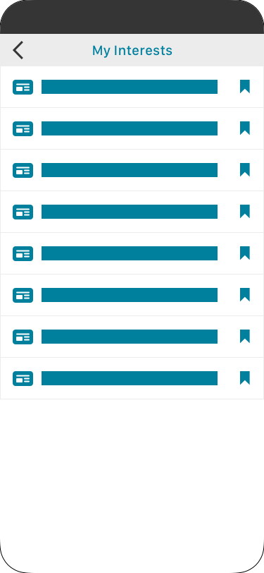
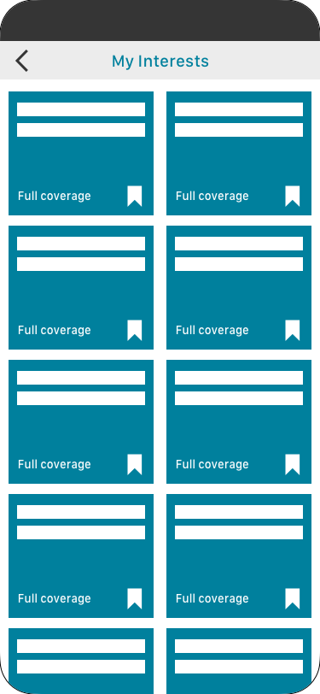
FOLLOW My Interests List
List View
Show more items
Clear for reading
2 Column List
Fill the whitespace
More direct by pics

Slide 91
FOLLOW CTA Button Status
Successfully Follow Notification
Status
Unfollow
Status
Followed
Successfully Unfollow Notification

Slide 92
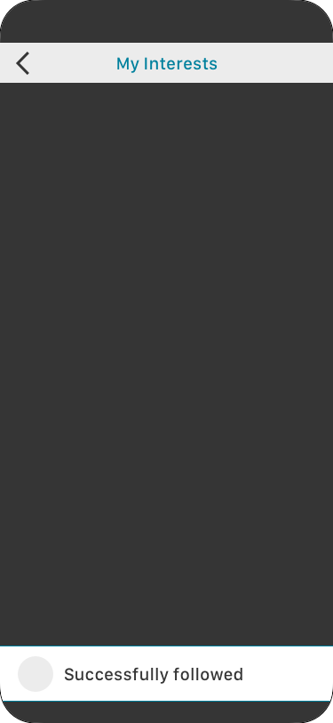

FOLLOW Follow/unfollow Notification
Bottom
Pop up

Slide 93


COMPETITORS
Google News Tab3
LinkedIn
Post saved status

Slide 94


3. SIGN-IN
If didn’t sign-in, pop up the sign-in notification

Slide 95


MANAGE: FOLLOW/UNFOLLOW
3. Sign-in
Reuters
11

Slide 96

4. Sign-in
Since the experience is embedded in the opal app, so the entry point would be less visible if we put this in the setting.
And also the current navigation is less useful for topics since they are on last position of the bar. It takes too much efforts to scroll down to that part.

Slide 97
User flow

Slide 98
After followed something, users want to keep in track but sometimes they are unable to read the updates or forget their reading progress.
Follow-up

Slide 99
PAIN POINT 3
LOST PROGRESS
233

Slide 100
Design direction 1
Keep on track
When they emerging in a long reading list, while scrolling down, the content is getting not up-to-date.

Slide 101
Make a more visible
personalized feed and navigation
HMW

Slide 102
Current Design
There are 10 coverage articles in the list and needed to scroll down 2-3 screen to view the next section like video or perspectives.

Slide 103



Design Scrolling Tracker
1

Slide 104
Design direction 2
Catch Updates
When they emerging in a long reading list, while scrolling down, the content is getting not up-to-date.

Slide 105
User flow 3
Know update
Read update
For You
Comprehensive View Page
Update List

Slide 106
Scenario
Staying up-to-date is the primary reason people use mobile news apps.(1)
Notes:
What could attract their focus?

Slide 107
Scenario
After receiving a mobile breaking news notification, most participants indicated that they read the notification to determine if it was worth engaging. If it met their interests or was contextually relevant, they might tap on it; if not, they wouldn’t. Their behavior was heavily based on context, location, and interest in the topic.
Mobile Breaking News Focus Group Findings, March 2017
Notes:
What could attract their focus?

Slide 108
Motivations
Icon
Icon
Know I have read all the updates since last time leave the app
Overall time period
Know the topics updates since last time leave the app
A certain topic

Slide 109
Design 1
“Check Mark”
233

Slide 110
Repeated news =boring content+ stupide algorithm
Use time read others

Slide 111


COMPETITORS
Instagram
A section separate read and unread news
LinkedIn
Untappable floating layer

Slide 112
Landing page of topics like the more than ten news on the comprehensive view page
The updates are countable
Requirement

Slide 113

DESIGN CATCH-UP
Show up in the list of news (Static)

Slide 114
DESIGN CATCH-UP
Pros
No need to read article last time they’ve read
Cons
Not like social content digestion, if last time they scroll down really quick, they may skip some important update

Slide 115
Design 2
“Updates”
233

Slide 116
Users don’t enable push notifications because they feel they already get too many.(1)
Trigger point

Slide 117

COMMON SOLUTION
Push notifications when your interests have updates
But that’s not a delightful experience, and may trigger unfollow and turn off the push actions.

Slide 118
Make users know topic’s updates more delightfully
HMW

Slide 119

DESIGN 1 PERSONALIZED UPDATES ON THE TOP
Show the update’s number of each topic
Tap the whole card hot spot jump to the comprehensive view page

Slide 120
DESIGN 1 PERSONALIZED UPDATES ON THE TOP
Pros
Show the thumbnail of topic to help users recalling this topic
Cons
If users only follow one topic, the layout would be weird

Slide 121

DESIGN 2 SPECIFIC UPDATES
Show topic’s updates in a carousel view
Show up this section when the update is more than a number
Tap view more jump to the topic comprehensive view page or news list

Slide 122
DESIGN 2 SPECIFIC UPDATES
Pros
Quickly know all the updates about a certain topic
Cons
Disturb the reading progress

Slide 123

NAVIGATION UPDATES
Separate personalized topics from fixed categories
Count the number of the update every topic has
Show +number to indicate
Tap edit jump to my interests page

Slide 124
NAVIGATION UPDATES
Pros
Directly know whether or not and number of updates
Cons
Some users may don’t know the number’s meaning

Slide 125
Showcase

Slide 126
Wrap-up 1
List View
233

Slide 127
Wrap-up 2
Comprehensive View
233

Slide 128
Wrap-up 3
Top Stories Browsing
233

